Slide 1
POWER BI • BUSINESS INTELLIGENCE PROJECT
Food Delivery Analysis
Dashboard using Power BI
Analyzing Orders, Revenue, Delivery Performance & Restaurant Performance
Presented by:
Nikita Ranga
Aaditya Naik
Rutika Agre
College:
B.R. Harne College of engineering and technology

Slide 2






Problem Statement & Objectives
Project Objectives
The Problem
01
Orders & Revenue
Track total orders and revenue
Food delivery companies receive thousands of orders daily. Monitoring delivery performance, customer satisfaction, and restaurant performance manually is challenging.
02
Delivery Performance
Analyze delivery performance
03
Food Categories
Identify popular food categories
A centralized Power BI dashboard is needed to convert raw order data into actionable, real-time operational insight.
04
Customer Ratings
Monitor customer ratings
05
Restaurant Performance
Evaluate restaurant performance
2

Slide 3






Tools & Dataset
Tools Used
Orders Dataset — Fields
Orders Table
Excel / CSV
Power BI Desktop
Order ID
Order Value
Source data
Dashboard development & visualization
Order Date
Delivery Time
Customer ID
Rating
Restaurant Name
Payment Method
Food Category
City
Power Query
DAX
Data transformation
Data analysis & calculated measures
These 10 fields form the foundation for every DAX measure and dashboard visual built in this project.
3

Slide 4




Data Analysis & Key DAX Measures
Data Flow
Excel / CSV
Power Query
Data
Transformation
DAX Measures
Power BI
Dashboard
Business
Insights
Key DAX Measures
Total Orders
Total Revenue
Avg. Delivery Time
Average Rating
Revenue Growth %
Analysis Areas Covered
Order & Revenue Analysis
Delivery Performance
Restaurant Performance
Customer Rating Analysis
City-wise Analysis
4

Slide 5
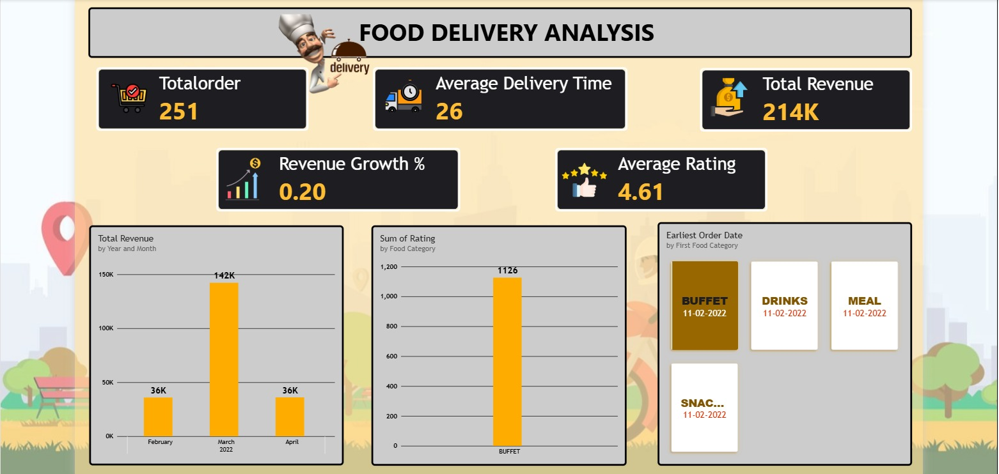
Dashboard Overview
Overview Highlights
Total Orders
Total Revenue
Average Rating
[ INSERT POWER BI OVERVIEW DASHBOARD SCREENSHOT HERE ]
Insert actual Power BI screenshot here
Provides an overall view of food delivery business performance through interactive KPIs and visualizations.
5

Slide 6
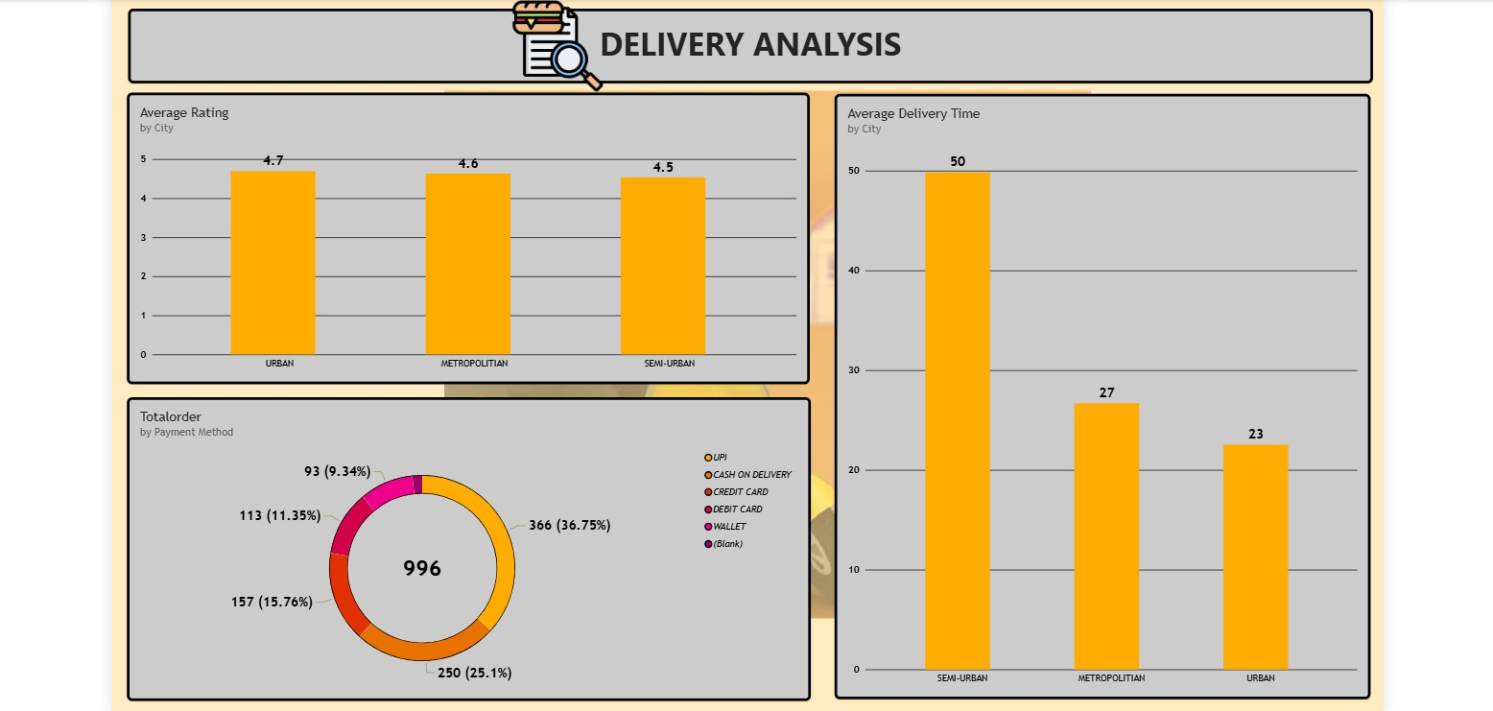


Delivery Performance Analysis
Analysis Covered
Delivery Time by City
Order Status Analysis
Delivery Performance Comparison
[ INSERT POWER BI DELIVERY ANALYSIS SCREENSHOT HERE ]
Insert actual Power BI screenshot here
Analyzes delivery performance across cities and helps identify potential delivery bottlenecks.
6

Slide 7
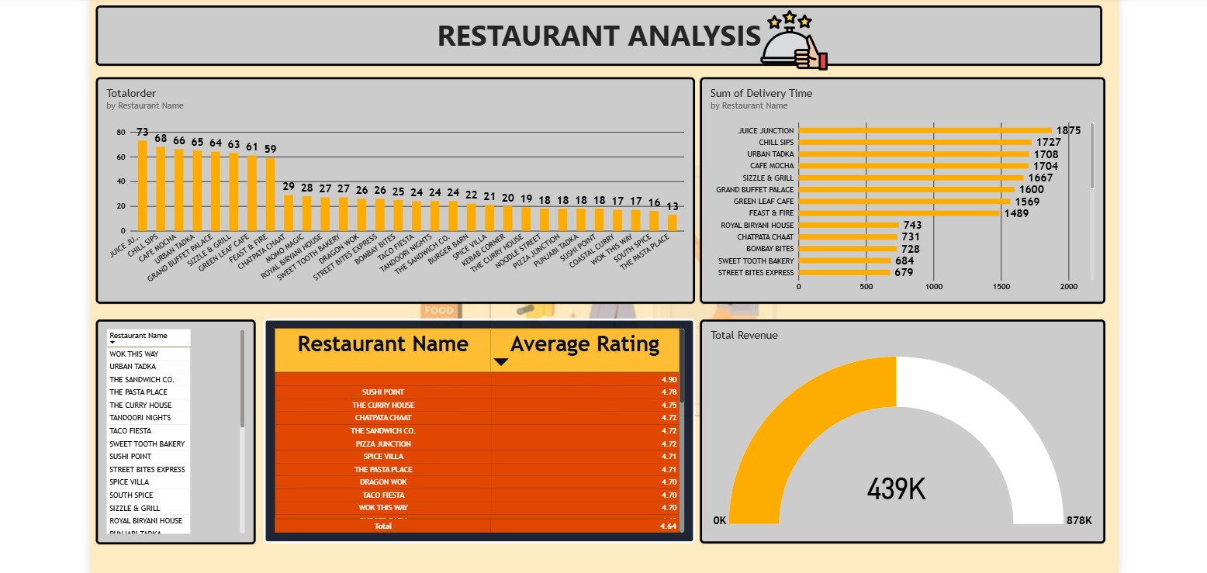






Restaurant Analysis & Business Insights
[ INSERT POWER BI RESTAURANT ANALYSIS SCREENSHOT HERE ]
Insert actual Power BI screenshot here
Top Restaurants
Revenue by Restaurant
Restaurant Performance
Key Business Insights
Delivery Bottlenecks
Popular Restaurants
Customer Satisfaction
Identify areas where delivery performance needs improvement
Identify restaurants receiving strong customer demand
Understand satisfaction trends through ratings
7

Slide 8





Conclusion
The Food Delivery Analysis Dashboard provides an interactive way to monitor food delivery operations using Power BI. It helps analyze orders, revenue, delivery performance, restaurant performance, and customer ratings, supporting better operational insights and data-driven decision-making.
Orders
Revenue
Delivery
Restaurants & Customers
Monitor order activity
Track business performance
Identify delivery issues
Evaluate performance & satisfaction
Thank You
Questions & Answers

